Slide 1
Introduction of Automobile Engineering

Slide 2
Introduction of Automobile Engineering
Definition of Automobile
A self-propelled passenger vehicle that usually has four wheels and an internal-combustion engine, used for land transport. Also called motorcar
Other types of motor vehicles include
buses, which carry large numbers of commercial passengers, and
medium- and heavy-duty trucks, which carry heavy or bulky loads of freight or other goods and materials.
Instead of being carried on a truck, these loads may be placed on a semitrailer, and sometimes also a trailer, forming a tractor-trailer combination which is pulled by a truck tractor.

Slide 3
How is an automobile made?
The automobile, for decades the quintessential American industrial product, did not have its origins in the United States.
In 1860, Etienne Lenoir, a Belgian mechanic, introduced an internal combustion engine that proved useful as a source of stationary power.
In 1878, Nicholas Otto, a German manufacturer, developed his four-stroke "explosion" engine. By 1885, one of his engineers, Gottlieb Daimler, was building the first of four experimental vehicles powered by a modified Otto internal combustion engine.
Also in 1885, another German manufacturer, Carl Benz, introduced a three-wheeled, self-propelled vehicle.
In 1887, the Benz became the first automobile offered for sale to the public. By 1895, automotive technology was dominated by the French, led by Emile Lavassor. Lavassor developed the basic mechanical arrangement of the car, placing the engine in the front of the chassis, with the crankshaft perpendicular to the axles.
In 1896, the Duryea Motor Wagon became the first production motor vehicle in the United States. In that same year, Henry Ford demonstrated his first experimental vehicle, the Quadricycle.
By 1908, when the Ford Motor Company introduced the Model T, the United States had dozens of automobile manufacturers. The Model T quickly became the standard by which other cars were measured; ten years later, half of all cars on the road were Model Ts. It had a simple four-cylinder, twenty-horsepower engine and a planetary transmission giving two gears forward and one backward. It was sturdy, had high road clearance to negotiate the rutted roads of the day, and was easy to operate and maintain.

Slide 4
Raw Materials
Although the bulk of an automobile is virgin steel, petroleum-based products (plastics and vinyls) have come to represent an increasingly large percentage of automotive components.
The light-weight materials derived from petroleum have helped to lighten some models by as much as thirty percent.
As the price of fossil fuels continues to rise, the preference for lighter, more fuel efficient vehicles will become more pronounced.

Slide 5
Design
Introducing a new model of automobile generally takes three to five years from inception to assembly.
Ideas for new models are developed to respond to unmet pubic needs and preferences.
Trying to predict what the public will want to drive in five years is no small feat, yet automobile companies have successfully designed automobiles that fit public tastes.
With the help of computer-aided design equipment, designers develop basic concept drawings that help them visualize the proposed vehicle's appearance.
Based on this simulation, they then construct clay models that can be studied by styling experts familiar with what the public is likely to accept.
Aerodynamic engineers also review the models, studying air-flow parameters and doing feasibility studies on crash tests.
Only after all models have been reviewed and accepted, tool designers are permitted to begin building the tools that will manufacture the component parts of the new model.

Slide 6
Chassis
The typical car or truck is constructed from the ground up (and out).
The frame forms the base on which the body rests and from which all subsequent assembly components follow. Such as,
Front and rear suspensions, gas tanks, rear axles and drive shafts, gear boxes, steering box components, wheel drums, and braking systems are sequentially installed.
An off-line operation at this stage of production mates the vehicle's engine with its transmission.
Workers use robotic arms to install these heavy components inside the engine compartment of the frame.
After the engine and transmission are installed, a worker attaches the radiator, and another bolts it into place.
Because of the nature of these heavy component parts, articulating robots perform all of the lift and carry operations while assemblers using pneumatic wrenches bolt component pieces in place.
Careful ergonomic studies of every assembly task have provided assembly workers with the safest and most efficient tools available.

Slide 7
The Future
The electric car has no engine, exhaust system, transmission, muffler, radiator, or spark plugs.
It will require neither tune-ups nor—truly revolutionary—gasoline.
Instead, its power will come from alternating current (AC) electric motors with a brushless design capable of spinning up to 20,000 revolutions/minute.
Batteries to power these motors will come from high performance cells capable of generating more than 100 kilowatts of power.
The hybrid electrical vehicle is powered by IC engine and electrical motor.
Electrical motor is powered by battery pack.

Slide 8
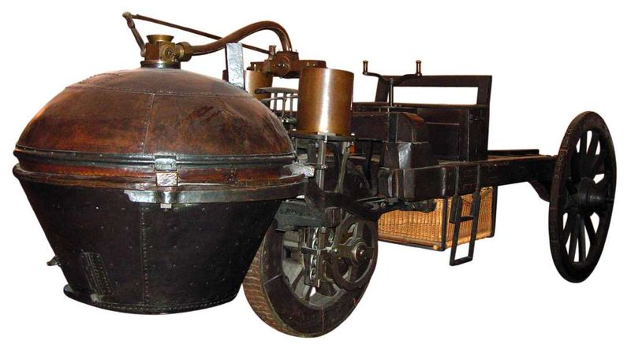
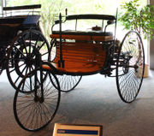
History of Automobile
Steam-powered self-propelled vehicles were devised in the late 17th century. A Flemish priest, Ferdinand Verbiest, was thought to have demonstrated in 1678 a small (24 in (61 cm) long) steam 'car'
First car to go into production with internal combustion engine in 1885.

Slide 9
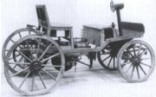
History of the Automobiles (Veteran Era)
First automobiles with gasoline powered internal combustion engines were completed almost simultaneously by several German inventors working independently:
Karl Benz built his first automobile in 1885 in Mannheim.
Benz was granted a patent for his automobile on January 29, 1886 and
began the first production of automobiles in 1888.
Italy's Enrico Bernardi, of the University of Padua, in 1882 patented a 0.024 hp (18W) 122 cc (7.4 in3) one-cylinder petrol motor, fitting it into his son's tricycle, making it at least a candidate for the first automobile, and first motorcycle.
One of the first four wheel petrol-driven automobiles built in Britain came in Birmingham in 1895 by Frederick William Lanchester who also patented the disc brake

Slide 10
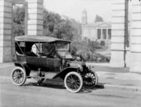
History of the Automobiles-continue
Named for the widespread use of brass in the United States, the Brass or Edwardian era lasted from roughly 1905 through to the beginning of World War I in 1914.
Brass or Edwardian era, the various experimental designs and alternate power systems was marginalized.
This system specified front-engined, rear-wheel drive internal combustion cars with a sliding gear transmission(manual transmission).

Slide 11
Throughout the history of Automobile:
development of automotive technology was rapid, due in part to a huge number (hundreds) of small manufacturers all competing to gain the world's attention.
Key developments included electric ignition by Robert Bosch, (1903),
independent suspension, and
four-wheel brakes (by the Arrol-Johnston Company of Scotland in 1909).
Leaf springs were widely used for suspension,
Transmissions and throttle controls were widely adopted, allowing a variety of cruising speeds,

Slide 12
Some examples of cars of the period included the following:
1908–1927 Ford Model T - The most widely produced and available car of the era.
It used a planetary transmission and had a pedal-based control system.
1910 Mercer Raceabout - Regarded as one of the first sports cars, the Raceabout expressed the exuberance of the driving public, as did the similarly-conceived American Underslung and Hispano-Suiza Alphonso
1910–1920 Bugatti Type 13 - A notable racing and touring model with advanced engineering and design. Similar models were the

Slide 13
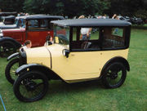
History of the Automobiles

Slide 14
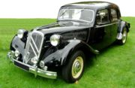
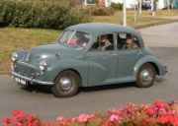
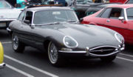
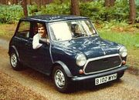

Slide 15
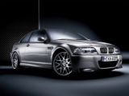
History of the Automobile (modern era)

Slide 16

History of the Automobile (Modern era)
Proton Saga
Proton Wira
Proton Satria
Proton Putra
Proton Perdana
Proton Tiara
Proton Juara
Proton Waja
Proton Arena
Proton Gen-2
Proton Savvy
Proton PERT
Proton Persona
Proton MPV

Slide 17
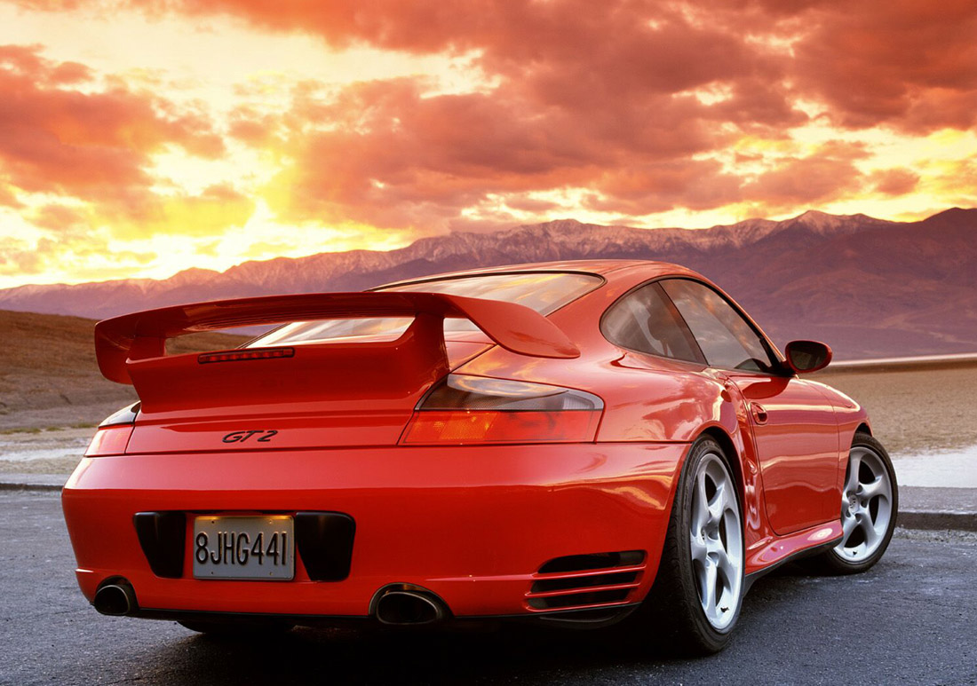
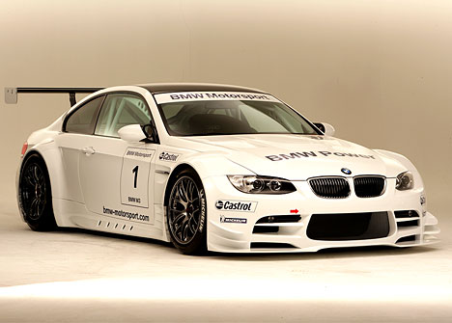
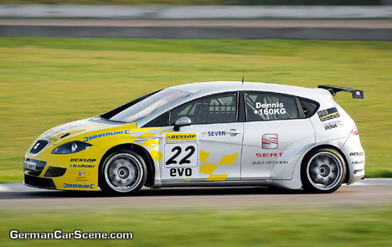
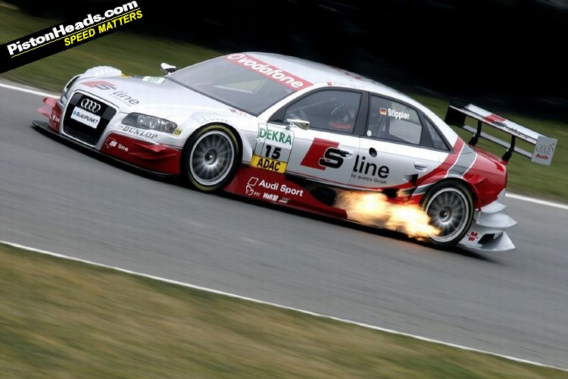

Slide 18
The major components of the modern automobile are
Engine
Power train
Suspension system
Steering system
Electrical system
Electronic control system
Safety system

Slide 19
Power system:
The power system includes the engine, the fuel supply, the exhaust system, and the heating and cooling systems.
The most common engines used today are internal-combustion engines that burn gasoline or diesel fuel.
Gasoline engines are used most often in passenger automobiles because they are small and light weight for the power they produce.
Diesel engines are more common in large trucks and buses because they are larger and heavier than gasoline engines and can better withstand heavy loads.
The engine is powered by the burning of a mixture of fuel and air, and produces the power that turns the wheels that makes the automobile move.
The exhaust system carries exhaust fumes outside of the automobile into the air and reduces engine noise.
The cooling system of an automobile cools off the engine that gets extremely hot when the automobile is running.
The heating system provides heat to the automobile and, today, most automobiles have air conditioners.

Slide 20
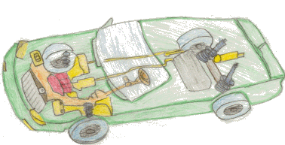

Slide 21
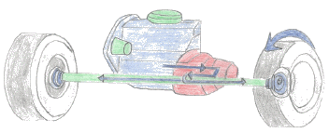
Power train
The major parts of the power train are the transmission, one or more drive shafts, gears, and axles.
These are the parts of an automobile that cause the wheels to turn.
The transmission transfers power from the engine to the drive shaft and uses
gears determine the speed of the automobile.
The drive shaft causes axles to rotate and turn the wheels.

Slide 22
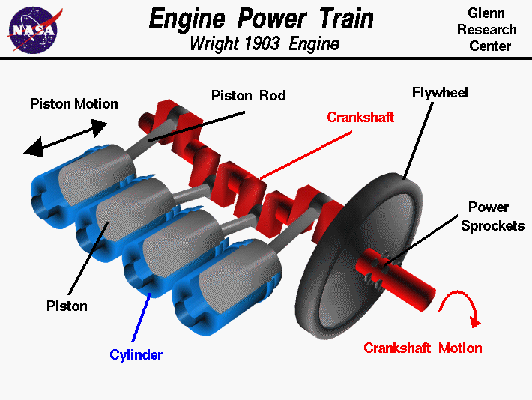
Power trains-continue

Slide 23
Crankshaft-transfering power to the transmission shaft

Slide 24
Support Systems
Support systems include the suspension system, wheels, and tires.
The suspension system contains springs that move up and down and allow a smoother ride on bumpy roads.

Slide 25
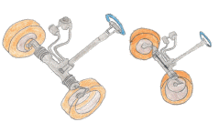
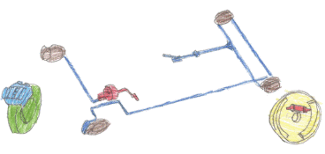
Control System
Steering and brakes make up the control system of an automobile.
The steering wheel controls the front wheels so the automobile can be turned in different directions.
Brakes allow the driver to reduce the speed or stop an automobile.

Slide 26
Electrical System
The electrical system provides the electricity necessary for starting the automobile and for operating the headlights, turn signals, horn, radio, windshield wipers, and other accessories.
A battery and an alternator supply electricity.
The battery stores electricity for starting the automobile and the alternator generates electric current while the automobile is running.
The main safety features built into automobiles are safety belts, air bags, and bumpers.

Slide 27
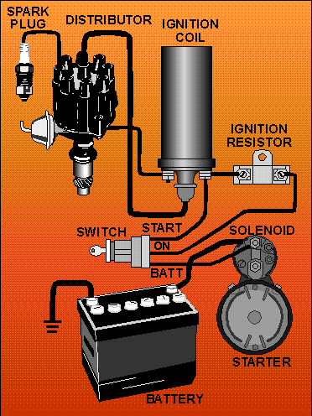
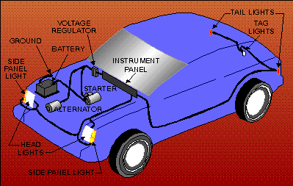
Electrical System of the automobile

Slide 28
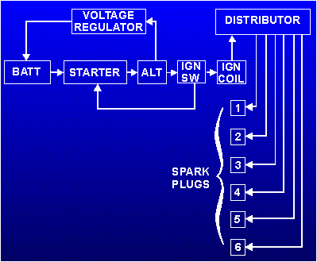
The battery is the initial source of power for the starter and ignition systems.
The starter is turned by power from the battery when the ignition switch is turned to the START position.
Power is also supplied, through the ignition switch, to the coil.
From the coil, power is supplied to the distributor and finally to the spark plugs for ignition.
Once the engine is running, the starter is no longer required.
The running engine acts as the prime mover for the alternator. (This is accomplished through a belt and pulley system attached to the engine's crankshaft.)
The alternator now takes over as the power supplier for the ignition system.
It supplies power through the ignition switch to the coil, from the coil to the distributor, and finally from the distributor to the spark plugs.
At the same time, the alternator supplies power back through the voltage regulator to the battery for charging purposes.
This completes the cycle until the engine is shut down and started again.

Slide 29
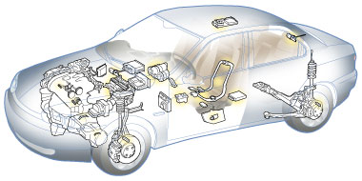
Control system of the automobile
Pump motor for fuel , Transmission unit , Engine control unit

